Slide 1
Customer Centered
Process Mapping

Slide 2

Maps Show a Persona Journey
Clarify the steps a persona takes to achieve a goal
Could be steps of an internal process to serve a customer
Identify the steps, pathway variations, pain points, & bottlenecks

Slide 3
Attributes of a Good Map
Simple (boxes and arrows)
Who is on the journey is clear
Is a complete story with a beginning, middle, and end. It includes common variances. And there are no missing steps.
Notes:
Roadmaps are an important communication tool for anyone going on the journey of Productization.
Especially in B2B services organizations, the path you will take is going to represent a significant transformation for the organization, so you need change management tools like Roadmaps to help everyone in the organization get on board.
In that vein there are two key outcomes that roadmaps provide:
They provide stakeholders with confidence in the path to achieving the vision.
And
They create alignment and accountability through public commitments.
For the first outcome, I use the term stakeholder very deliberately. There are many different types of stakeholders you will need to communicate the path with - and I’ll talk a bit more about that in just a minute. For each of these stakeholders, your roadmap provides an at least somewhat VISUAL tool that enables them to better connect with how you aim to achieve the vision. This gives them confidence that you have a solid plan, and the space for them to add additional strategic context that could help you. This assumes there is a product vision and business objectives to start with. If those don’t exist your organization needs to build them. In some cases, a first draft of a roadmap can be a way to help get the conversation started on a vision and objectives for the product.
For the second outcome, one of the things you will need to drive as a product leader is alignment around your plan. It is important that the stakeholders understand where you are going.
The fact that you are stating that path publicly gives them confidence, but it also gives YOU confidence that everyone is aligned.
Stakeholders want clarity on what is happening, but they often also want to know how they can best support the business’s success.
When there is a single unifying roadmap, everyone can be confident they are singing off the same sheet of music and not setting expectations internally or with customers that we’re not even aware of.
An important side-effect here is that without a roadmap, you are going to get a lot of calls, emails, slack messages and meeting requests from people who want to know priorities and status of the productization work. Sharing the roadmap openly, often on an internal wiki and through a regular communication cadence can alleviate a ton of this noise in your life, but more importantly, drive that alignment and structured feedback you really want.
Transition 1 (3 common mistakes): Now, this sounds simple, just two things, right? Provide confidence in the plan to achieve the vision, and create alignment and accountability. Unfortunately it’s easier said than done. Many organizations that do not use roadmaps correctly end up falling into a few common traps, and end up struggling. So let’s talk about those mistakes, and how we can avoid them.
Transition 2 (with Boxing slide): Now, this sounds simple, just two things, right? Provide confidence in the plan to achieve the vision, and create alignment and accountability. Unfortunately it’s easier said than done. Many organizations that do not use roadmaps correctly and product managers can feel like they’re really getting beaten up all the time about it…

Slide 4
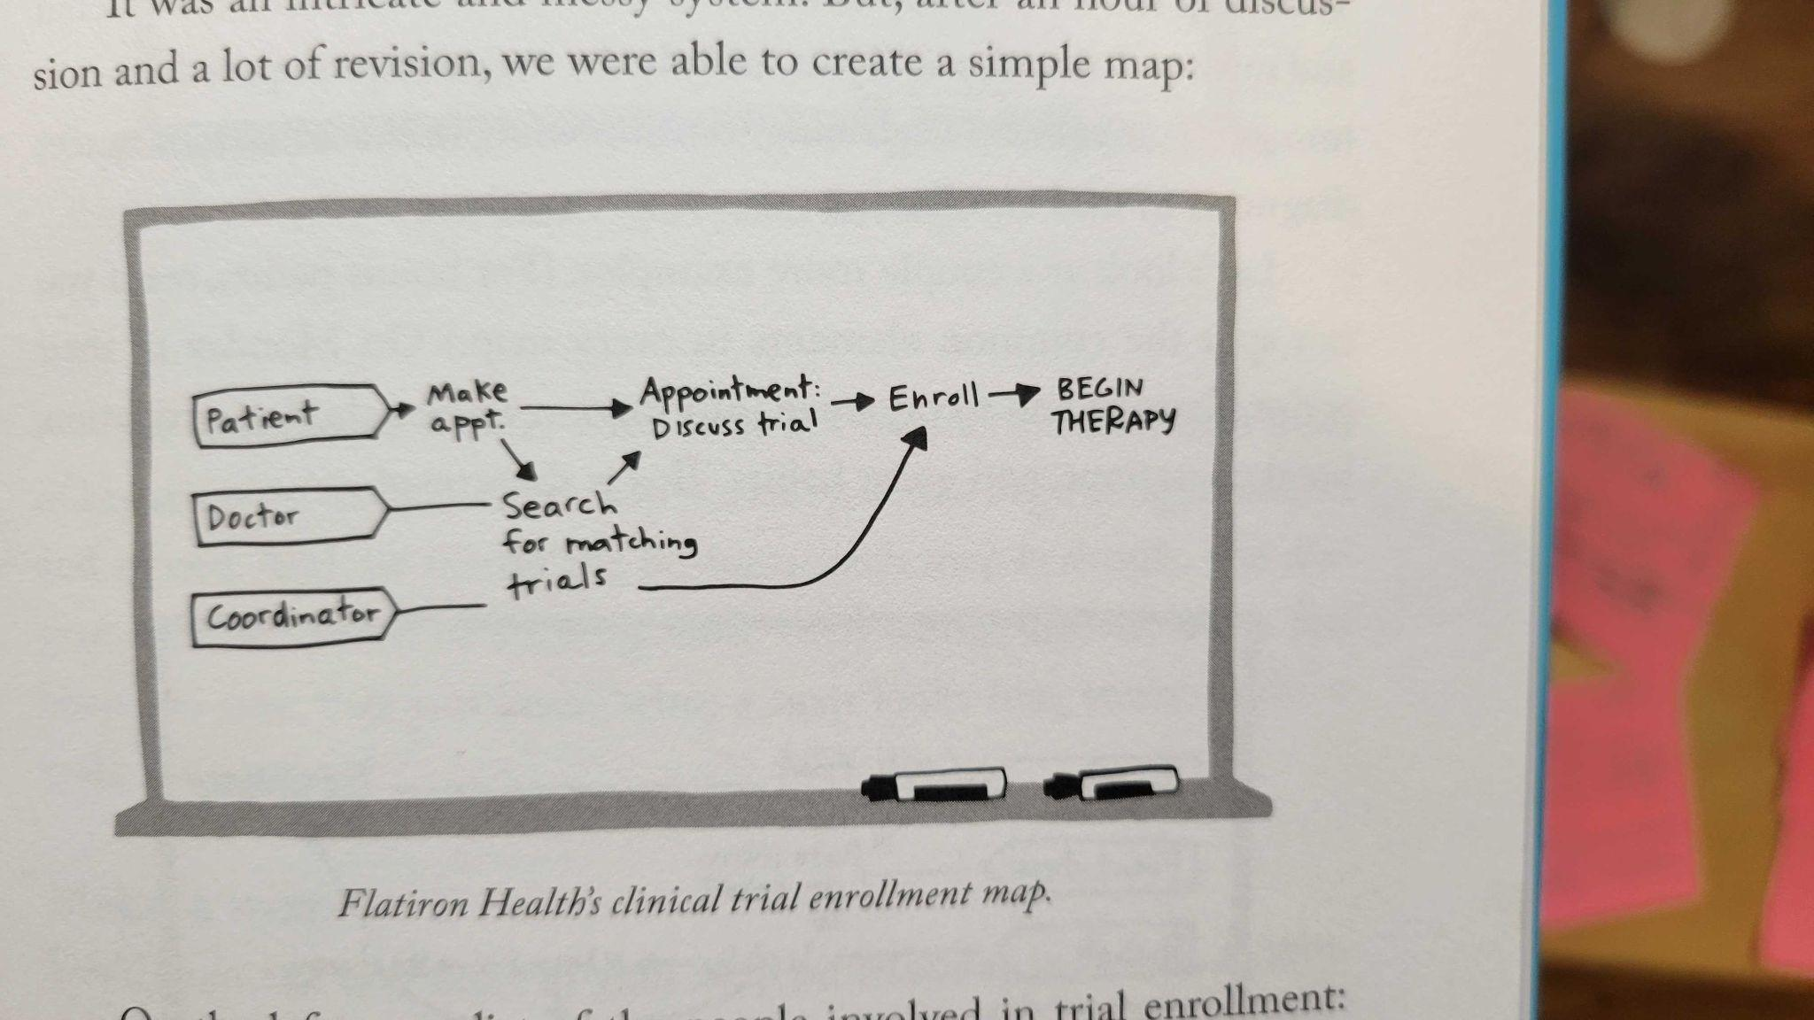
Example: Flatiron Health Clinical Trial Enrollment
Buyer Goal: Enroll qualified patients in clinical trials.
Source: p. 63 from Sprint

Slide 5
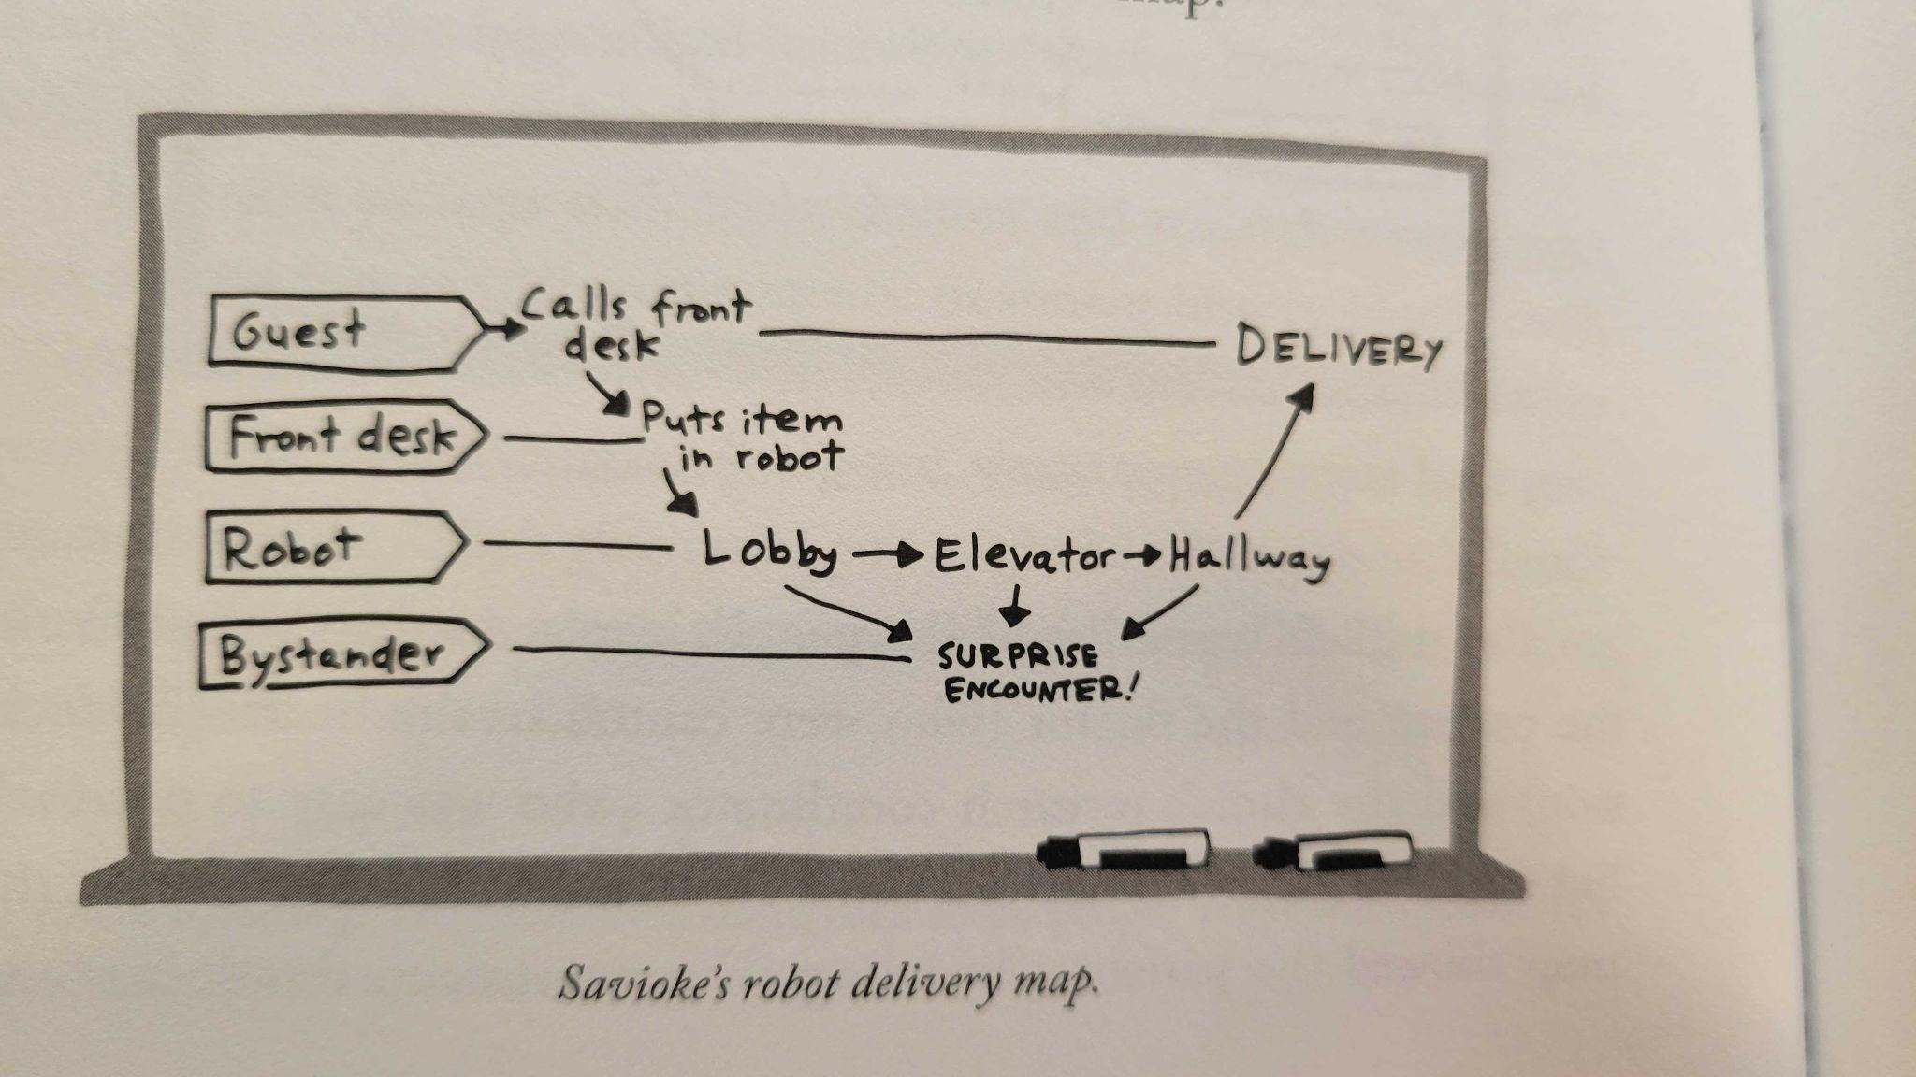
Example: Savioke Hotel Robot
Buyer Goal: Request item from front desk (e.g. extra towels, toothbrush, room service).
Source: p. 64 from Sprint

Slide 6
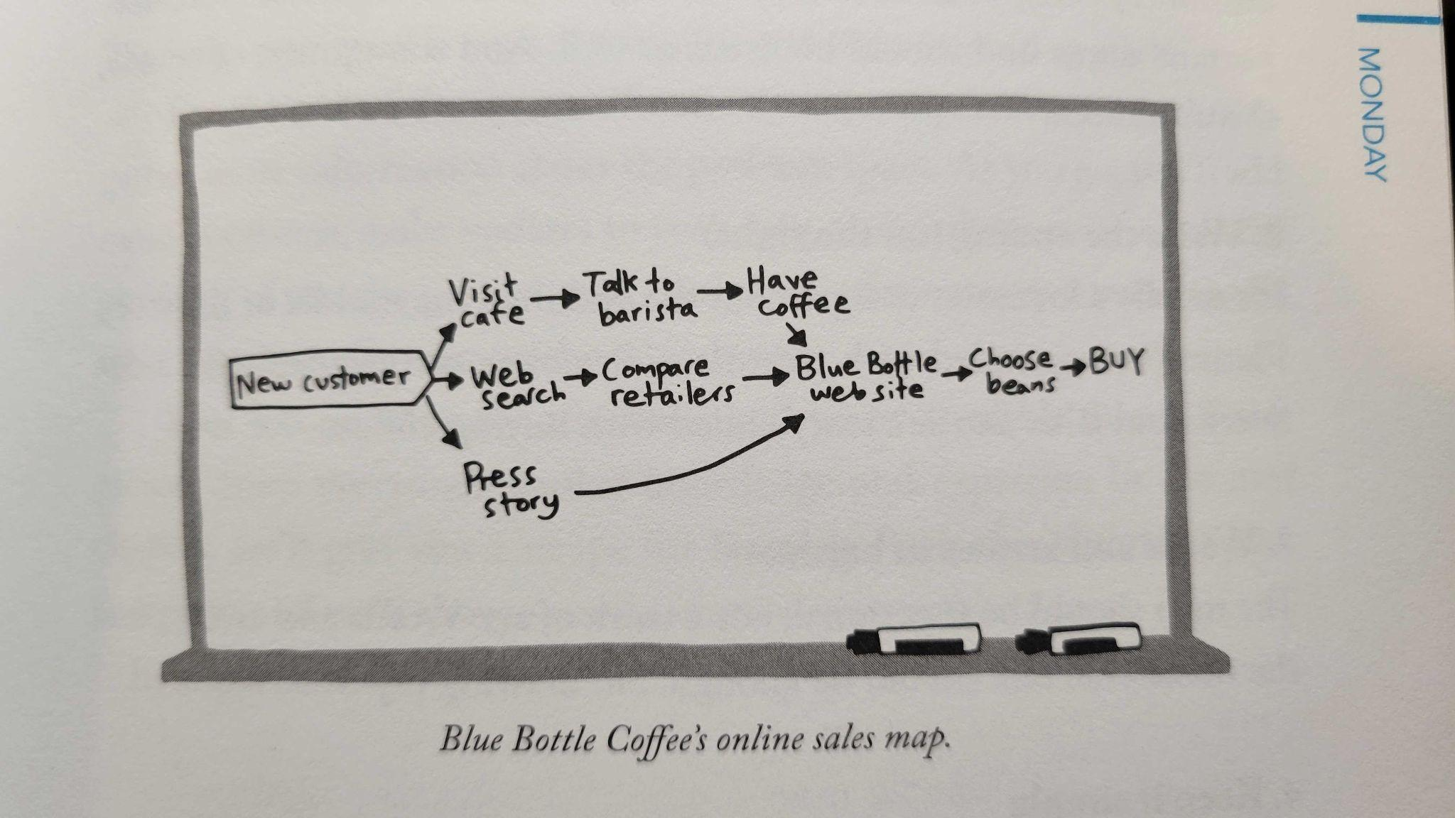
Example: Blue Bottle Coffee
Buyer Goal: Buy coffee beans
Source: p. 65 from Sprint

Slide 7
Example: CEB Pulse Surveys
Buyer Goal: Analyze & distribute engagement survey results based on manager, departments, and groups (organizational hierarchies).
Note - this is just one part of a larger journey.
Determine Need for Hierarchy (enable)
Create Manager Hierarchy from Directory
Map Fields from Directory
Build Hierarchy from Directory
Add survey participants by Hierarchy
Hierarchy Available in Survey Logic and Dynamic Fields
Hierarchy Set-up in Reporting
Analyze: Admins Filter and Compare by Hierarchy
Create Demographic Hierarchy from Directory
Warning if Current Hierarchy is out of Sync with Directory
View/Navigate Manager Hierarchy
Set User Permissions With Mgr Hierarchy
Analyze: Results distributed to managers only for their teams
Create Hierarchy from Upload
Edit Hierarchy: Employee Add, Edit, Delete
Create Hierarchy from Integration
Edit Hierarchy: Node (Mgr / Demo) Add, Edit, Delete
Merge Multiple Directories from Business Units
Multiple Edits at a Time
Source: Work document created by Sean Gillispie while at CEB, edited to share with Vecteris clients.

Slide 8
Additional resources
Sprint
HBR, The Customer Centered Innovation Map

