Slide 1
Pricing Survey Questions
Van Westendorp & Gabor Granger

Slide 2
Van Westendorp Price Sensitivity Model
A technique for determining consumer price preferences. Indirectly measures willingness to pay, using a range of prices, instead of asking potential buyers to identify a single price point.
These four questions are posed:
At what price would you consider the product to be so expensive that you would not consider buying it? (Too expensive)
At what price would you consider the product to be priced so low that you would feel the quality couldn’t be very good? (Too cheap)
At what price would you consider the product starting to get expensive, so that it is not out of the question, but you would have to give some thought to buying it? (Expensive/High Side)
At what price would you consider the product to be a bargain—a great buy for the money? (Cheap/Good Value)
The collective data should be visualized on a line graph with price on the x-axis and the number of respondents on the y-axis. The graph should plot the cumulative number of people believing the product too cheap and too expensive at each potential price. (Shown on next page)
The Van Westendorp model reveals the ideal range of pricing.
Rebecca Shaddix, “How to Price Your Product: A Guide To The Van Westendorp Pricing Model,” Forbes, Jan 9, 2023, https://www.forbes.com/sites/rebeccasadwick/2020/06/22/how-to-price-products/#:~:text=The%20Van%20Westendorp%20Model%3A%20Determining,the%20question%20to%20potential%20buyers.

Slide 3
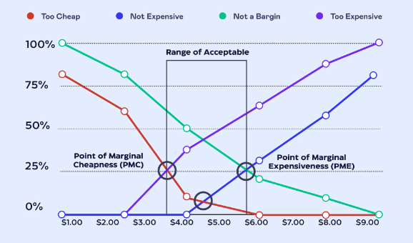
Van Westendorp Price Sensitivity Model
Example Graph
Rebecca Shaddix, “How to Price Your Product: A Guide To The Van Westendorp Pricing Model,” Forbes, Jan 9, 2023, https://www.forbes.com/sites/rebeccasadwick/2020/06/22/how-to-price-products/#:~:text=The%20Van%20Westendorp%20Model%3A%20Determining,the%20question%20to%20potential%20buyers.

Slide 4
Gabor Granger Pricing Model
A simple, but effective technique for determining price elasticity of products and services.
People are asked the likelihood of purchasing a product or service at different price points.
For example, “Would you buy this product/service/etc. at X price?”
If they say yes, the same question is asked with a higher price point.
If they say no, the same question is asked with a lower price point.
This continues until the model determines the highest price they are willing to pay.
The data is then plotted on a demand and revenue curve to determine the optimum price to deliver the maximum revenue. (See next page.)
“Gabor Granger Pricing Model,” B2B International, accessed Aug 15, 2024, https://www.b2binternational.com/research/methods/pricing-research/gabor-granger/

Slide 5
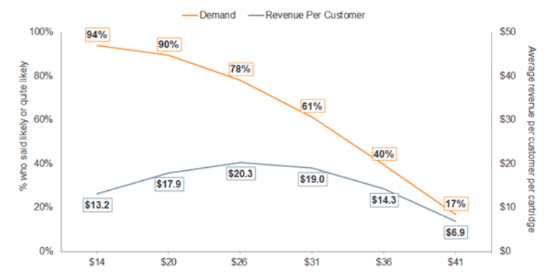
Van Westendorp Price Sensitivity Model
Example Graph
“Gabor Granger Pricing Model,” B2B International, accessed Aug 15, 2024, https://www.b2binternational.com/research/methods/pricing-research/gabor-granger/

