Slide 1
GTM Checklist & Templates

Slide 2
GTM Checklist
 | Supporting Documents | Owner | Status | Notes
Goals (revenue, awareness)
Urgent & expensive problem (and its root causes) defined
Target market segments and buyer personas
Competitive positioning
Messaging by persona including urgency, disagreement, benefits, differentiators
Pricing & Packaging Strategy
Customer experience journey
Product Branding

Slide 3
GTM Checklist (cont’d)
 | Supporting Documents | Owner | Status | Notes
Marketing tactics for both awareness & demand gen, assets & goals
Defined sales process
Sales enablement tools & tactics; sales training
Contracts, Product Codes
Risks & Mitigants
Customer success measures
Product gap analysis
Customer-facing roadmap

Slide 4
Urgent & Expensive Customer Problems
Problem & Root Causes | Urgency Driver | Economic Impact | Target Segment | Buyer Personas | User Personas
©2020 Vecteris – FOR INTERNAL USE ONLY – DO NOT DISTRIBUTE

Slide 5
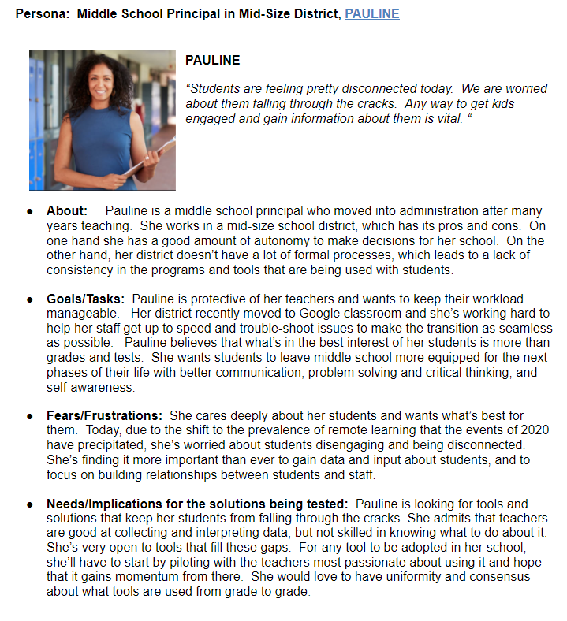
Target Market Segments / Buyer Personas
Persona | About | Goals & Tasks | Fears/ Frustrations | Implications for messaging
©2020 Vecteris – FOR INTERNAL USE ONLY – DO NOT DISTRIBUTE

Slide 6
Competitive Differentiation Grid
 | Features |  |  |  | Attributes |  | Reputation Client List, Tenure | OVERALL Competitiveness
Company/Product | Feature 1 | Feature 2 | Feature 3 | Feature 4 | Pricing | Data quality
 | * | * |  | * | * |  | * | High
 |  | * | * |  | * |  |  | High
 | * | * |  | * |  |  | * | High
 |  |  |  |  |  |  | * | High
 | * |  |  |  |  |  | * | Moderate
 |  |  |  | * |  |  |  | Moderate
 |  |  |  |  |  |  |  | Moderate
 |  |  |  |  |  |  |  | Low
 |  |  |  |  |  |  |  | Low
 |  |  |  |  |  |  |  | Low
©2020 Vecteris – FOR INTERNAL USE ONLY – DO NOT DISTRIBUTE

Slide 7
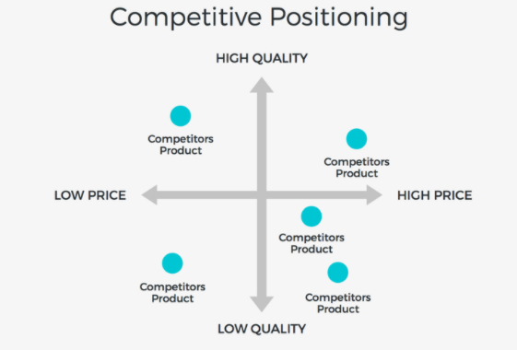
Competitive Positioning
High Quality
US
2
4
Low Price
High Price
Competitor 1
3
Low Quality
©2020 Vecteris – FOR INTERNAL USE ONLY – DO NOT DISTRIBUTE

Slide 8
Customer Journey / Experience Maps
Discovery (Marketing) | Decide (Sales) | Delivery (Services, CS, Support) | Value Realization | Renewal
Customer activities & personas
Activities & owners
Timeframe
©2020 Vecteris – FOR INTERNAL USE ONLY – DO NOT DISTRIBUTE

Slide 9
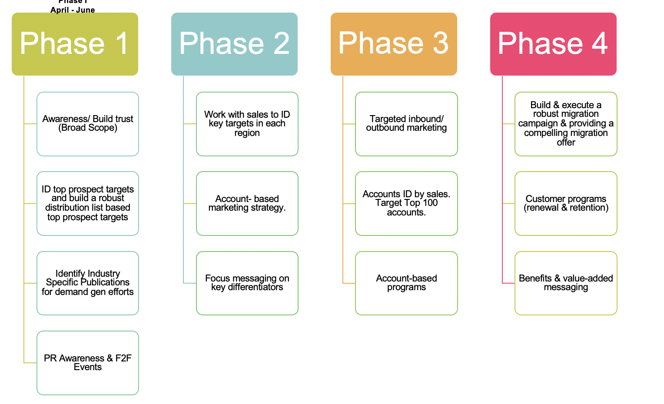
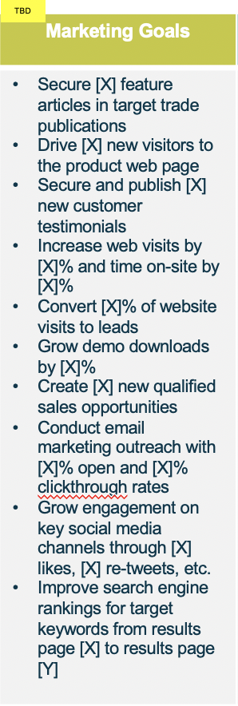
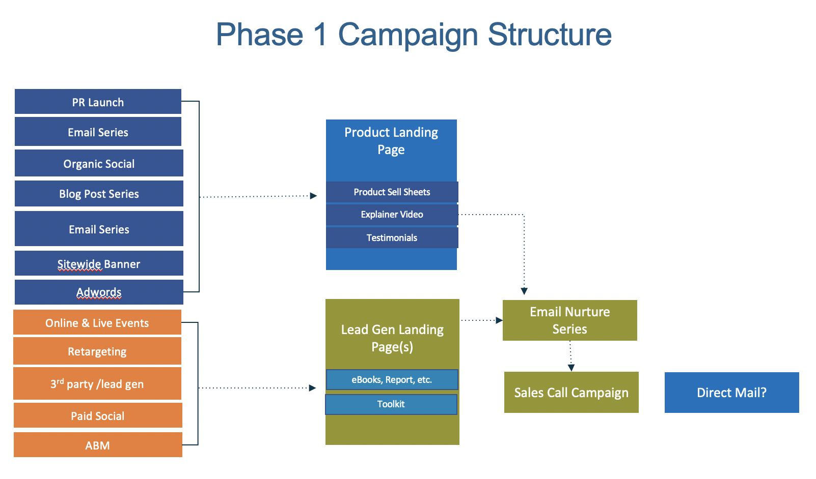
Marketing Tactics for Awareness & Demand Gen (w/assets & goals)
Phase | Tactics | Assets | Goal
Awareness
Competitive Differentiation
Upsell
Retain
©2020 Vecteris – FOR INTERNAL USE ONLY – DO NOT DISTRIBUTE

Slide 10
Defined Sales Process
Step 1 | Step 2 | Step 3 | Step 4 | Step 5 | Step 6 | Step 7
Activity
Sales Tools
Sales Support
©2020 Vecteris – FOR INTERNAL USE ONLY – DO NOT DISTRIBUTE

Slide 11
ROI Template
[Header]
Product:
Tagline:
Intro Paragraph:
Cost avoidance or value generated summarized
Product features: Cost Displacement
Feature $12,000
Feature
Feature $10000
Feature $500-2,000
Feature $1,000-$3,000
Implementation Consultant Support $15,000-$60,000
Product Benefit: Value Created
Benefit 1 $5,000-$6,000 per person
Benefit 2 $8,000-$10,000 per team
©2020 Vecteris – FOR INTERNAL USE ONLY – DO NOT DISTRIBUTE

Slide 12
FAQ / Objection Handling
Objection | Solution 1 | Solution 2
Can’t buy right now because of COVID
Data “lift” required
©2020 Vecteris – FOR INTERNAL USE ONLY – DO NOT DISTRIBUTE

