Slide 1


How to Transform a Services Culture and Successfully Productize

Slide 2
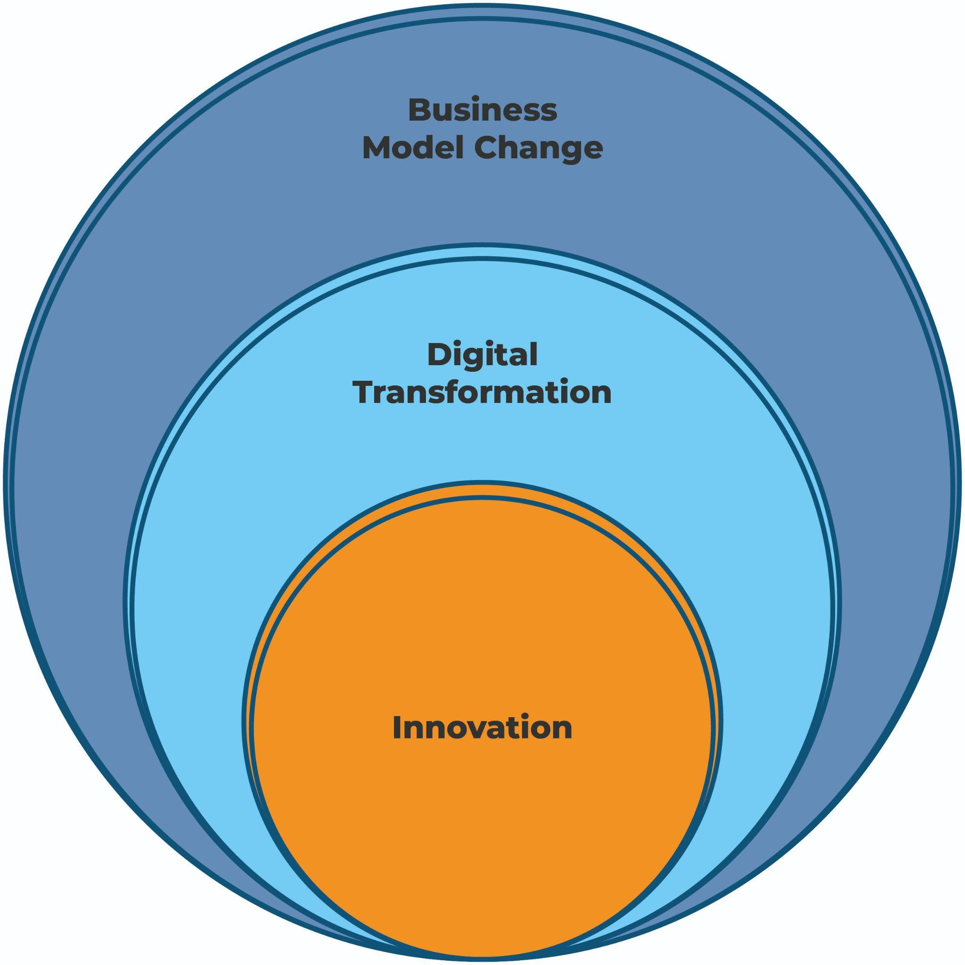
Elements of Successful Productization

Slide 3
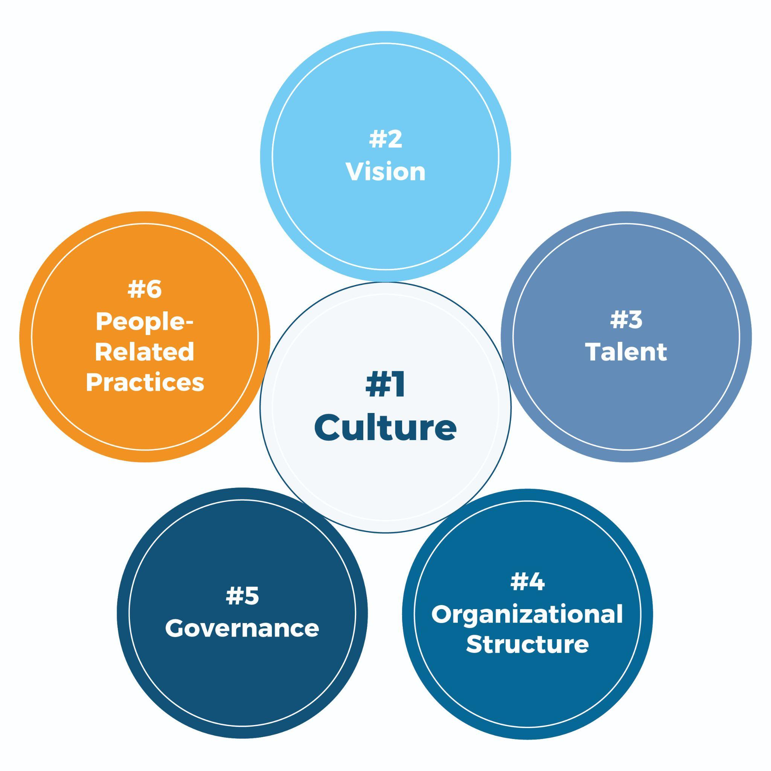
Six Levers to Build a Product-Friendly Organization

Slide 4
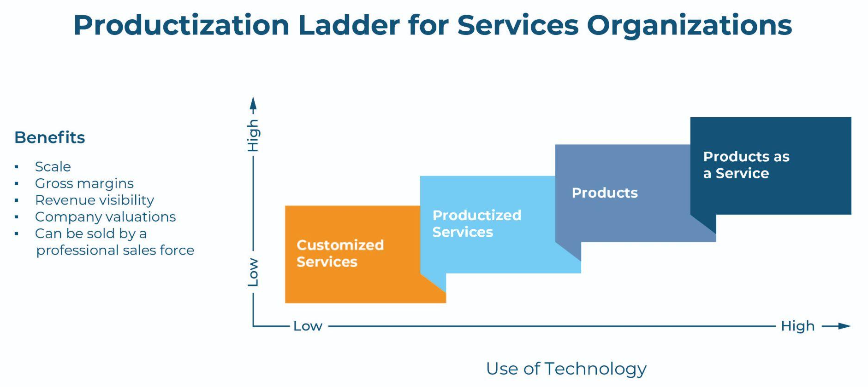
B2B Services Companies are Pursuing ‘Product’ Strategies to Scale & Compete

Slide 5
The Four Horsemen of Productization & Their Antidotes
Knowing You believe you need to be the expert and struggle to admit when you are wrong or don’t know. | Discovering You believe in being curious and are open to changing your mind. You know admitting when you are wrong leads to better outcomes for everyone.
Perfectionism You believe personal worthiness is defined by work performance and that all work needs to be (nearly) flawless to be valuable. | Speed You believe that testing ideas before iterating creates the best work.
Scarcity Thinking You believe existing resources are fixed and that the amount customers will spend with you is more limited than it actually is. | Abundance Thinking You believe more resources can be found. You see the world as expanding and are willing to risk cannibalization.
Individual Heroics You believe that asking for help is a sign of weakness and that individual performance is more valuable than group performance. | Collaboration You believe that performance improves when you work across teams, with clients, and with other partners in the ecosystem.
FEARFUL | FEARLESS

Slide 6
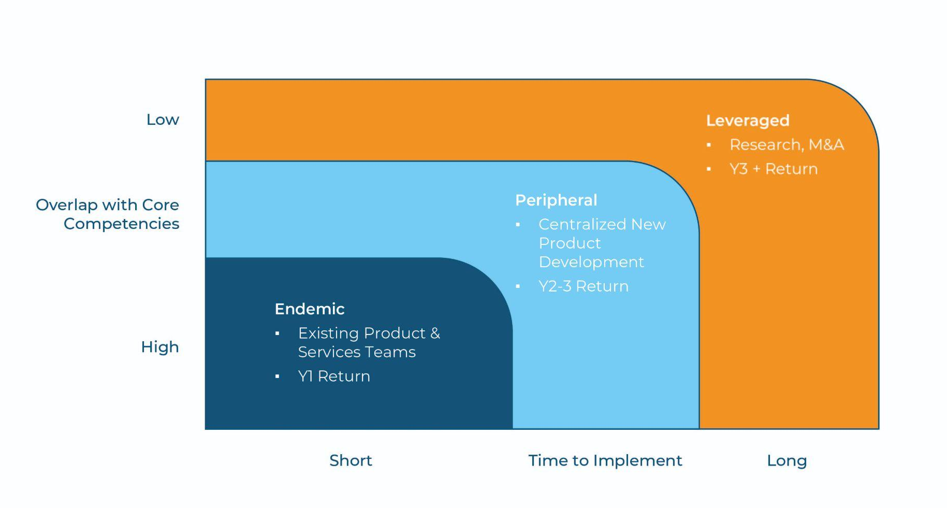
Three Horizons Framework
OVERLAP WITH CORE COMPETENCES
TIME TO IMPLEMENT

Slide 7
A Significant Shift for Services Organizations
When we move...
From...
…To
1:1
1:Many
Selling time and expertise
Selling (often tech-enabled) intellectual property
Our behavior and culture needs to shift...
From...
…To
Knowing
Discovering
Scarcity Thinking
Abundance Thinking
Perfection
Speed
Individual Heroics
Cross-functional Collaboration

Slide 8
Top 7 Product Innovation Mistakes
Starting too big or too perfectly
Focusing on processes before people
Aligned to favor core business, rather than new products
Developing products that don’t solve an urgent & expensive customer problem
Designing &
developing in
a vacuum
Fear of cannibalization hinders sales & marketing
Stopping
at the MVP

Slide 9
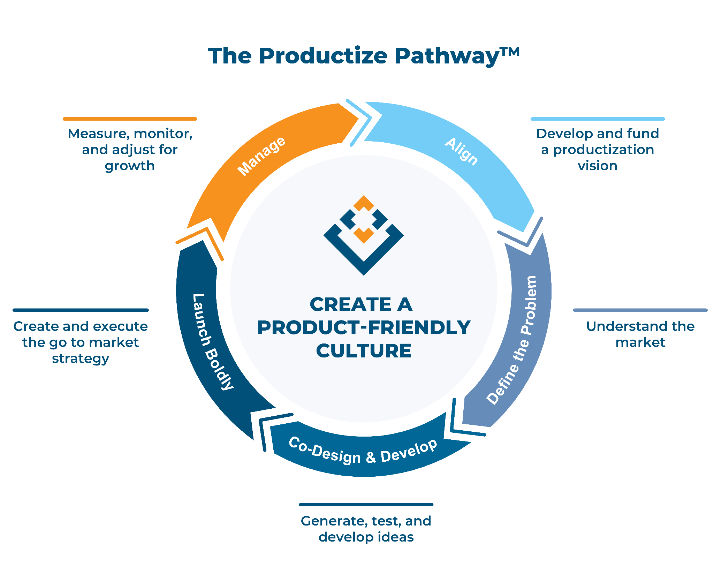


The Productize Pathway™ Helps B2B Services Organizations Build Product Innovation Capabilities

Slide 10
